Slide 1

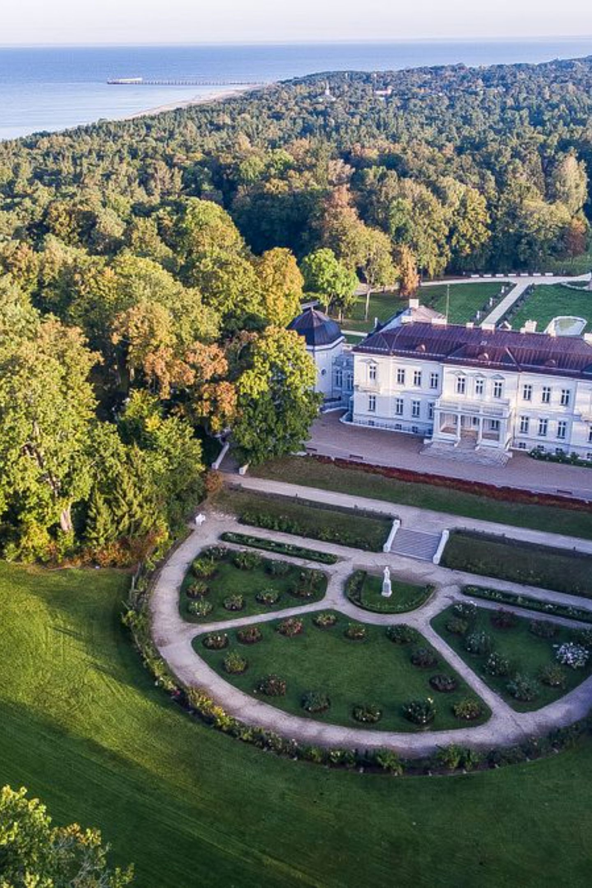

Analysis of Tourism Statistical Data for Palanga City Municipality
2012–2025 | Tourist flows, overnight stays, accommodation supply, markets and comparison of Lithuanian resorts

Slide 2

The analysis was prepared using data summaries from the Official Statistics Portal compiled by Palanga TIC. It covers tourist flows, overnight stays, the structure of domestic and foreign tourists, accommodation capacity, and comparative indicators for four Lithuanian resorts.
The primary unit of analysis is a tourist who stayed in an officially registered accommodation establishment. This data does not include day visitors and may not fully reflect informal short-term rentals.
2024–2025 Fluctuations
Analytical Principle
Conclusions are based on long-term trends and a combination of indicators, rather than single-year changes.
Exceptionally large – possible changes in statistical coverage and registration methodology must be taken into account.

Slide 3
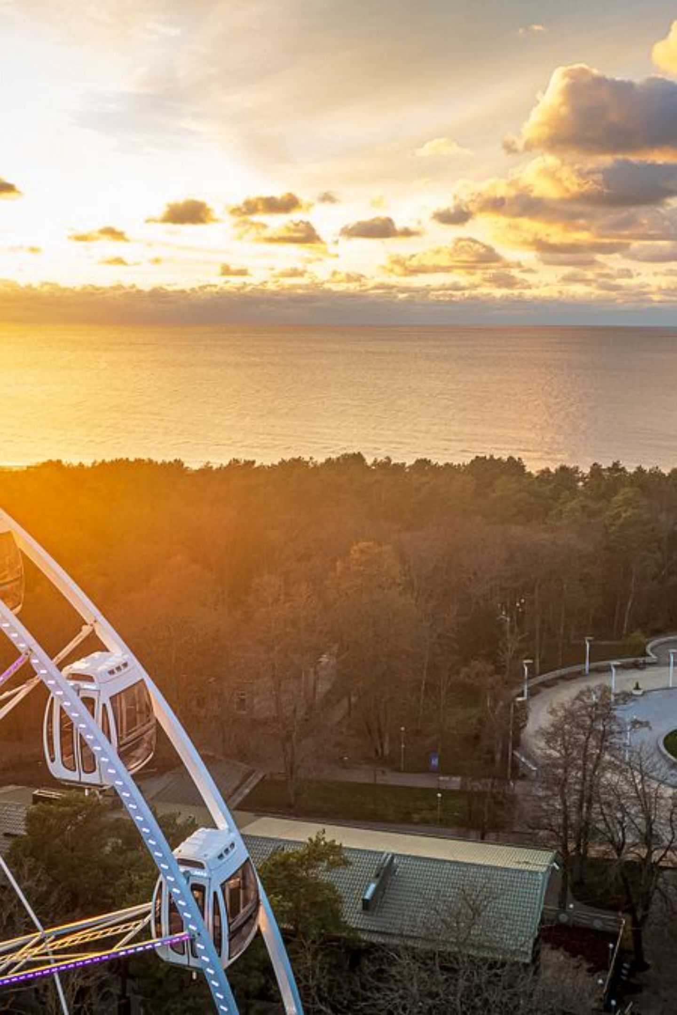
Summary
165,6%
7,8%
Tourist Growth
Annual Growth Rate
From 198.7k (2012) to 527.9k (2025)
Average annual compound growth rate
−49,4%
10,9%
Length of Stay
Foreign Tourists
From 4.45 to 2.25 overnight stays over the period
Share in 2025 (was 18.9% in 2019)

Slide 4
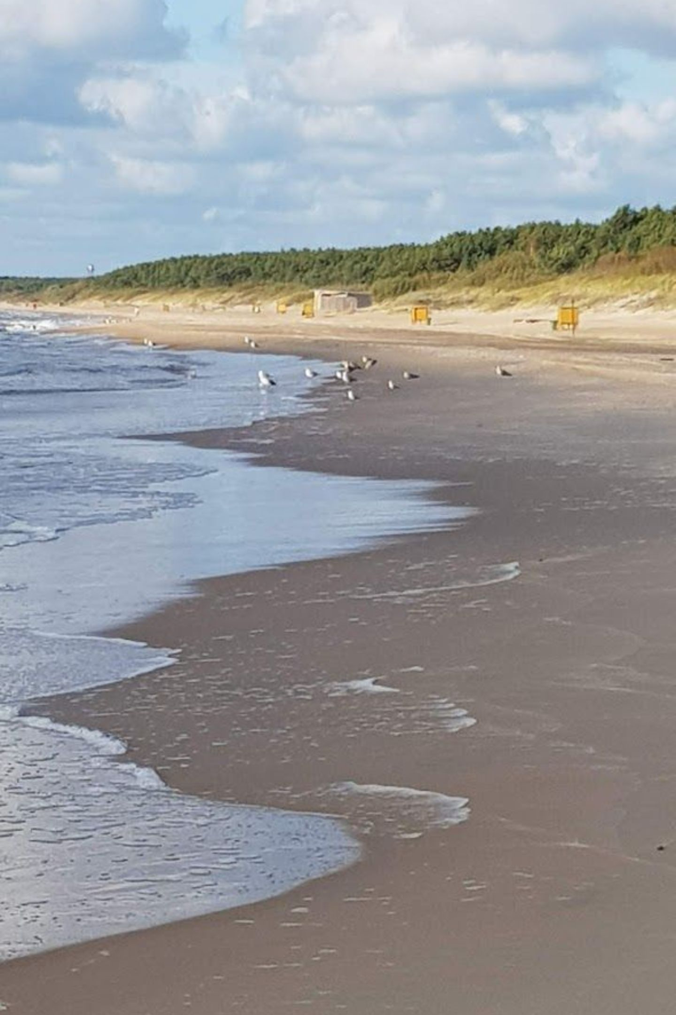
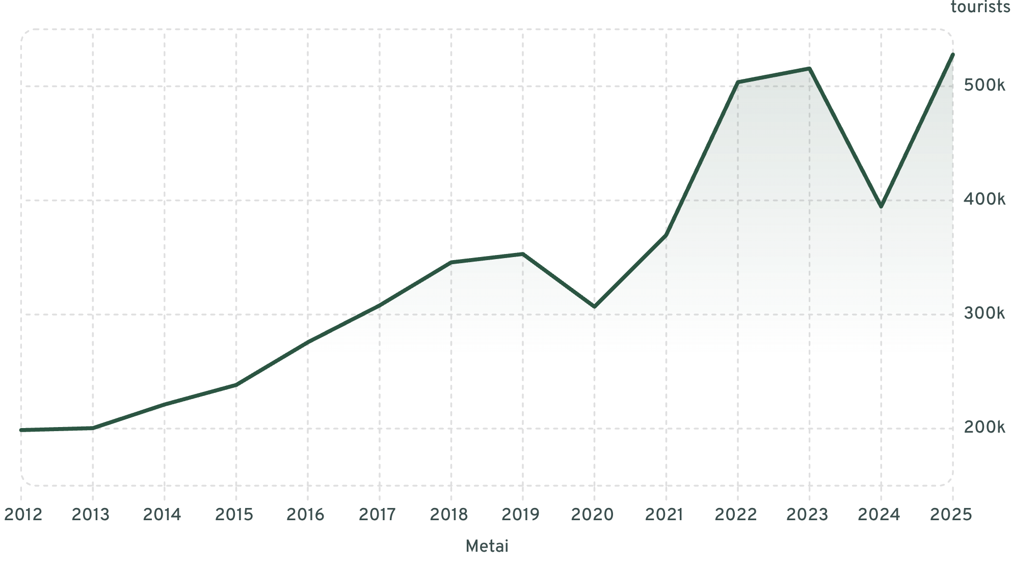
2. Tourist Flow Dynamics
Tourist numbers grew steadily between 2012 and 2019 (+77.7%). The pandemic caused a −13.1% decline in 2020. In 2025, the highest figure on record was reached – 527,875 tourists. The amplitude between 2024 and 2025 is too large to be explained by market changes alone – this period must be assessed within a methodological context.

Slide 5
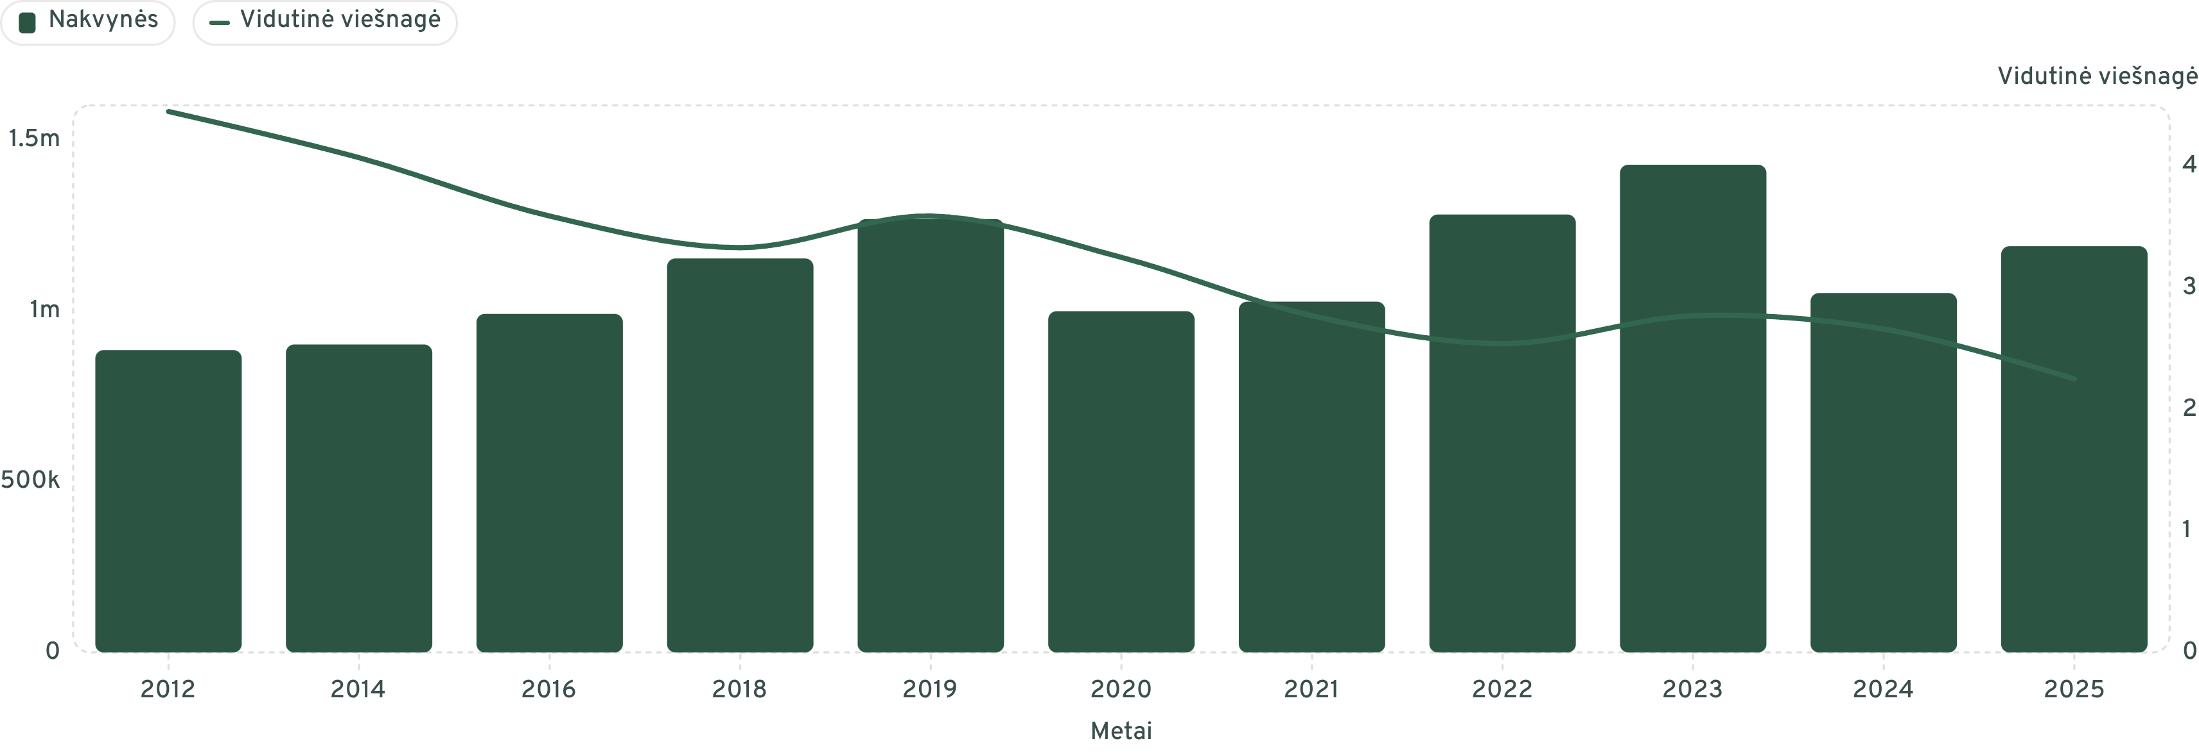
3. Overnight Stays and Length of Stay
The number of overnight stays grew by only 34.4%, whilst tourist arrivals increased by 165.6%. The average length of stay fell from 4.45 to 2.25 nights (−49.4%). Palanga needs not only more arrivals, but also more reasons for visitors to stay a third, fourth, or fifth night.

Slide 6
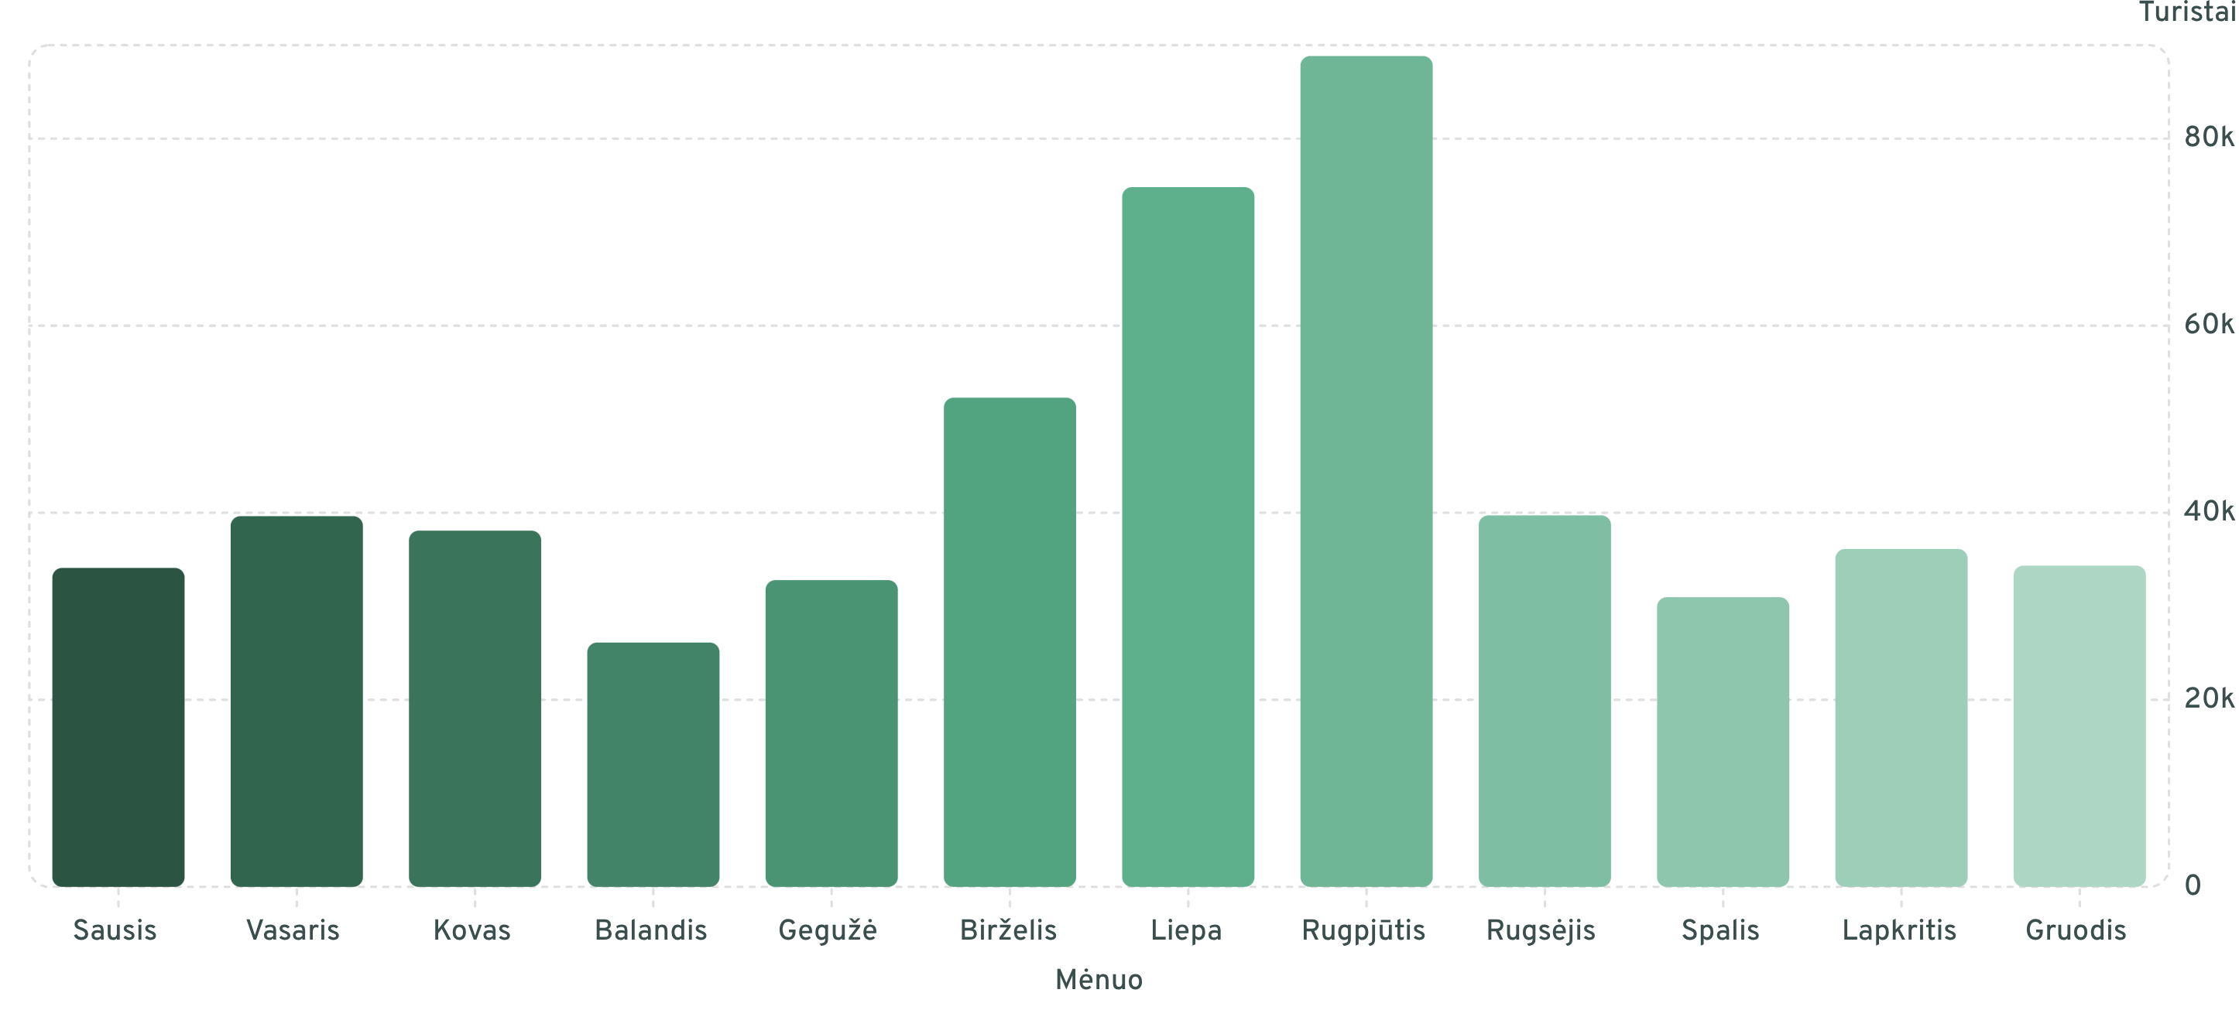
4. Seasonality
June–August accounted for 40.9% of tourists and 50.0% of overnight stays. In August, the flow was more than twice the monthly average. The average length of stay in July was 2.91 nights, and in December 1.74 nights. The greatest potential for extending the season lies in April–May and September–October.

Slide 7
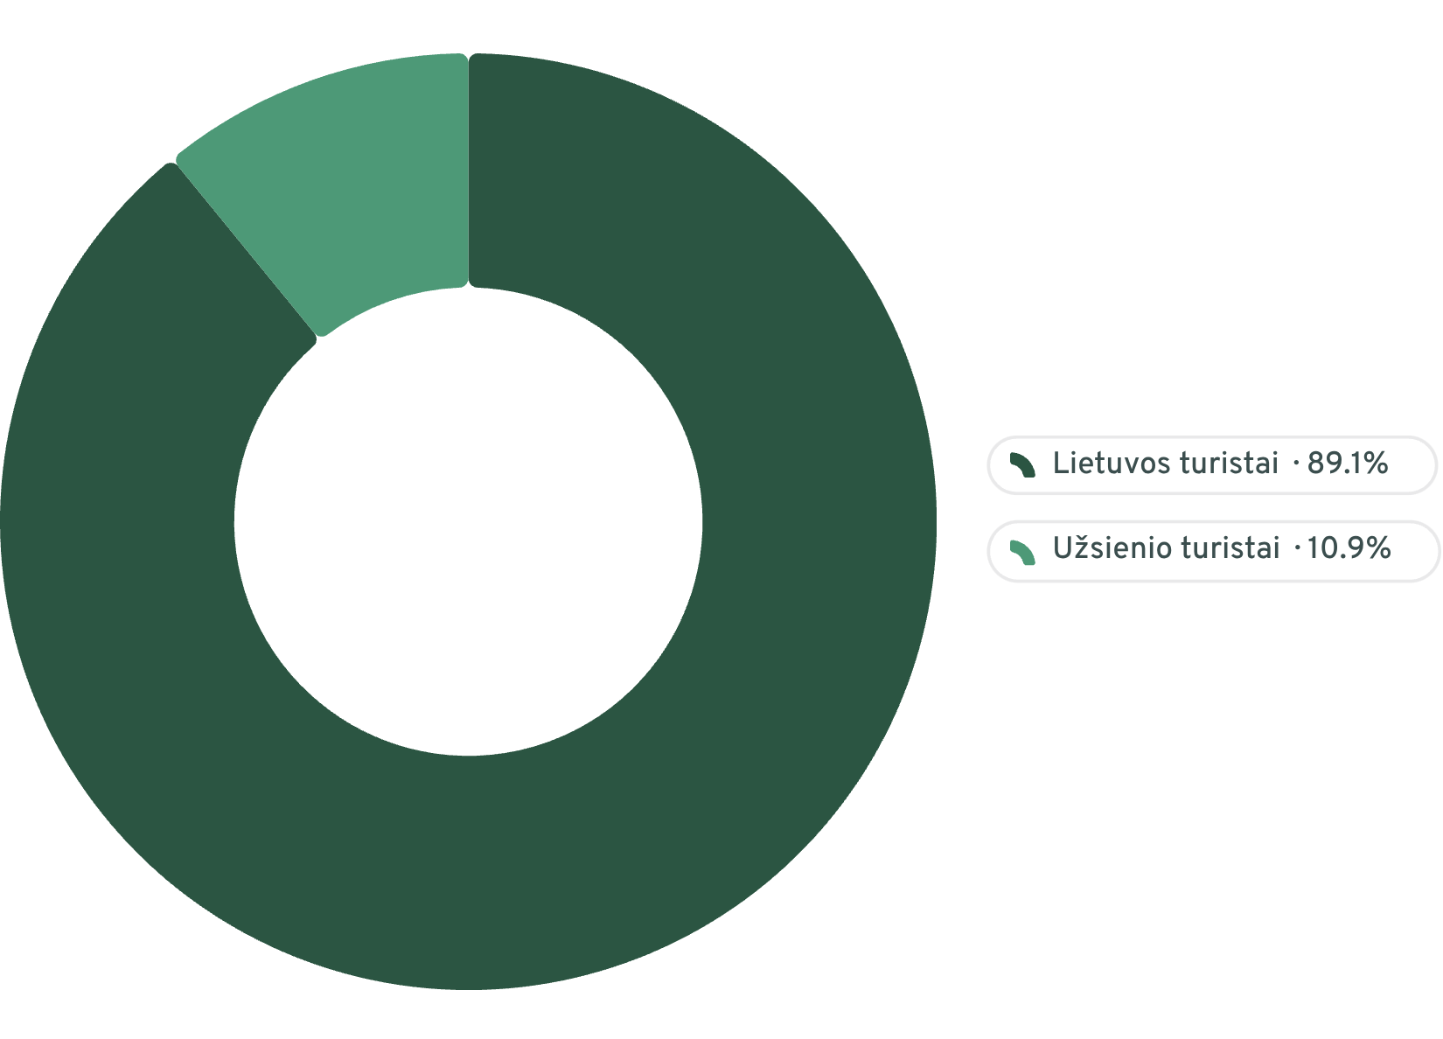
5. Structure of Domestic and Foreign Tourists
Structural Changes
In 2025, domestic tourists accounted for 89.1% and foreign tourists for 10.9%. In 2019, the foreign tourist share stood at 18.9%, meaning the international tourism structure has not yet returned to pre-pandemic levels.
Risk
Opportunity
A strong domestic market provides resilience, but long-term growth cannot rely solely on Lithuanian travellers.
Increasing the foreign share to 15% would mean approximately 22,000 additional foreign tourists.

Slide 8
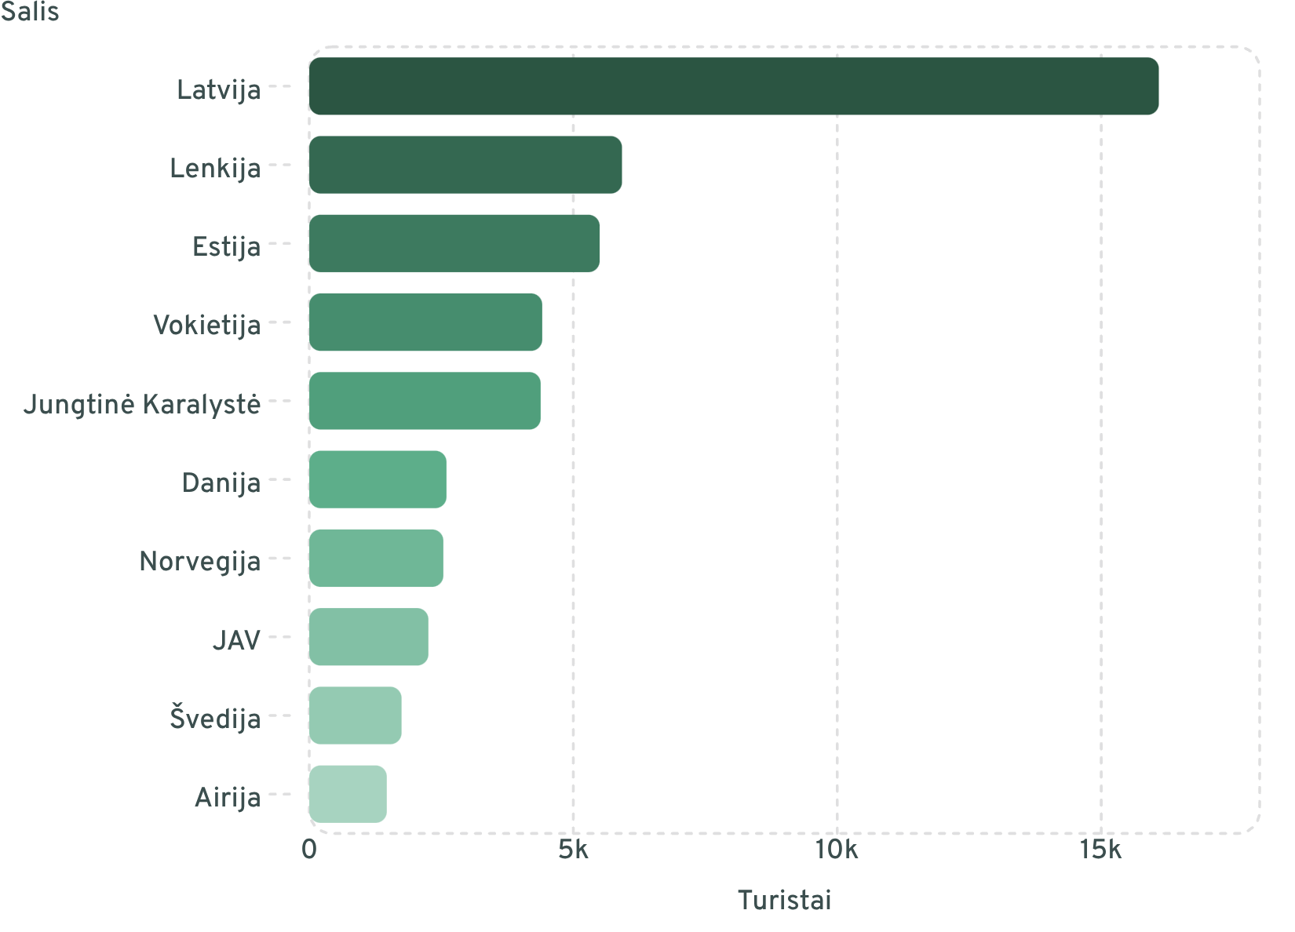
6. Foreign Markets: TOP 10
Latvia alone accounted for 28.1% of the total foreign tourist flow. The five largest markets combined accounted for 63.3%.
Priority
Growth
Latvia, Poland, Estonia, Germany – sustained marketing and season extension.
UK, Denmark, Norway, Sweden – wellness, active leisure, events.
High Value
USA, Israel, Ireland – Baltic routes, culture, diaspora.

Slide 9
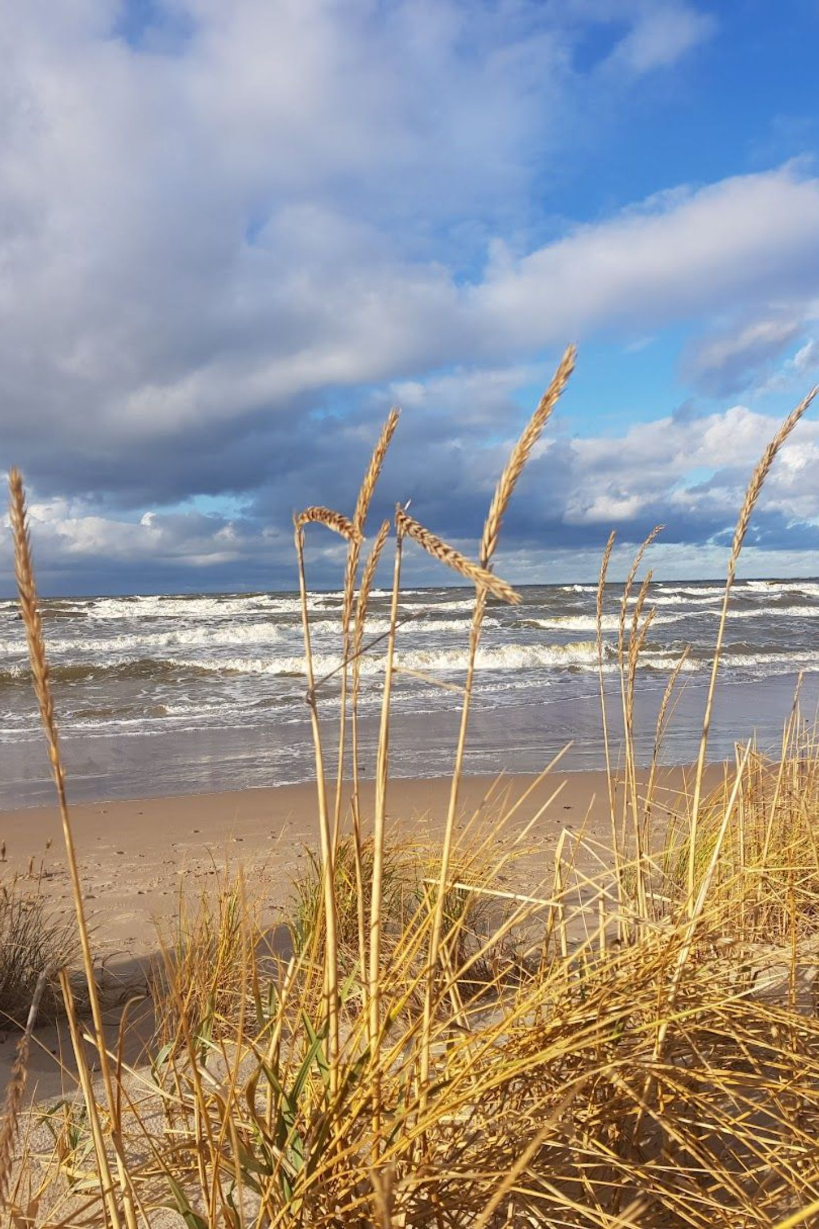
7. Accommodation Sector
644
5 742
Establishments in 2025
Rooms in 2025
From 226 (2012) – growth of +185%
From 4,140 (2012) – growth of +38.7%
15 802
92,7%
Beds in 2025
Short-term Accommodation
From 10,656 (2012) – growth of +48.3%
Share of all registered establishments in 2025
The number of establishments grew considerably faster than the number of rooms and beds – indicating market fragmentation and the expansion of small providers. The number of rooms per establishment fell from 18.3 to 8.9. Palanga's challenge is not a shortage of beds – the key task is to increase occupancy of existing capacity during the off-season.

Slide 10
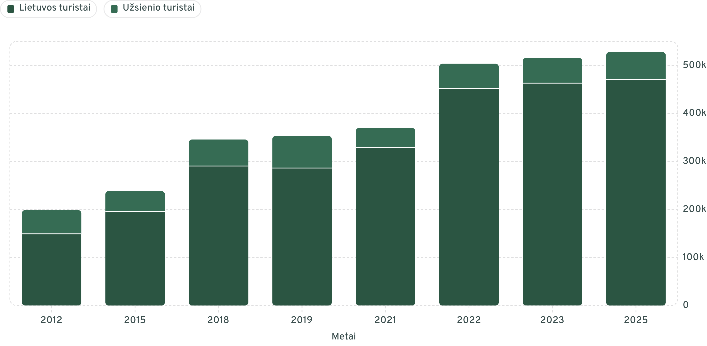
Growth Trajectory: Tourists vs. Overnight Stays
The dominance of domestic tourists increased following the 2020 pandemic. The absolute number of foreign tourists in 2025 – 57,537 – still falls short of the 2019 level (66,772). This confirms that the recovery of international tourism in Palanga is progressing more slowly than domestic tourism.

Slide 11
Key Indicators Summary
Indicator
2012
2019
2025
Change 2012–2025
Tourists
198 721
353 028
527 875
+165,6 %
Overnight Stays
884 344
1 267 548
1 188 304
+34,4 %
Average Length of Stay
4,45
3,59
2,25
−49,4 %
Foreign Tourist Share
24,9 %
18,9 %
10,9 %
−14.0 pp
Accommodation Establishments
226
447
644
+185,0 %
Accommodation Beds
10 656
16 759
15 802
+48,3 %

Slide 12
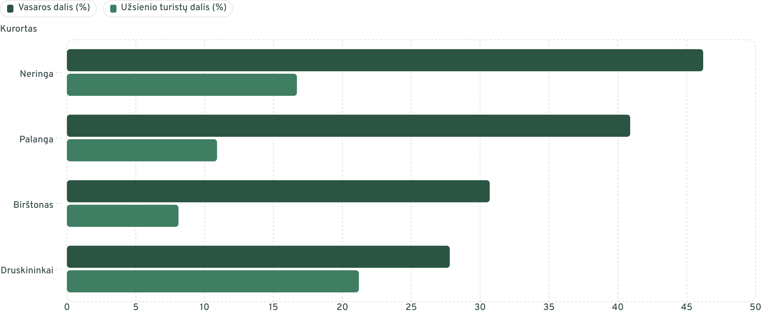
Seasonality Comparison: Lithuanian Resorts
Palanga is less seasonal than Neringa, but considerably more seasonal than Druskininkai and Birštonas. The Druskininkai model – lower summer concentration and a higher share of foreign tourists – is the clearest benchmark for Palanga's strategy.

Slide 13
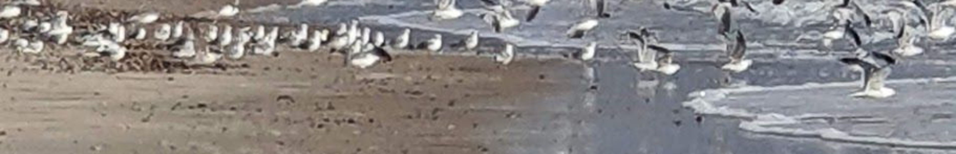
10. KPI System
KPI
2025 Baseline
2030 Target
Assessment Logic
Number of Tourists
527 875
600–650k
Growth without an excessive summer peak
Number of Overnight Stays
1 188 304
≥1.55m
Grow faster than tourist numbers
Average Length of Stay
2,25
≥2,50
At least +0.25 nights
Foreign Tourist Share
10,9 %
≥15 %
Market diversification
Jun.–Aug. Tourist Share
40,9 %
≤38 %
Reducing seasonality
Off-season Overnight Share
50,0 %
≥55 %
Year-round demand
Bed Utilisation Rate
~75 nights/bed
Steady growth
Capacity efficiency

Slide 14

12. Is Palanga Becoming a Year-Round Resort?
Palanga already attracts significant tourist flows throughout the year, yet the concentration of overnight stays and longer visits in summer remains pronounced. It would be more accurate to say that Palanga is moving in the direction of a year-round resort, but this transition is not yet complete.
Domestic Market
Foreign Markets
Will continue to be the primary source of stability, but its growth has natural limits.
Latvia, Poland, Estonia – greatest potential for scale. Germany, UK, Scandinavia – higher value and off-season opportunities.
Climate Change
Longer warm spring and autumn periods may expand active and nature tourism, but increase the need for weather-independent products.

Slide 15
Which Products Should Be Developed First?
Wellness and Medical Tourism
Sports Events and Training Camps
An integrated city-level offer, not merely the promotion of individual establishments.
Training camps and sporting competitions during the off-season.
Conference and Business Tourism
Spring and Autumn Packages
MICE events, workations, and longer-stay packages.
Nature, cycling, cultural, and gastronomic weekends.

Slide 16
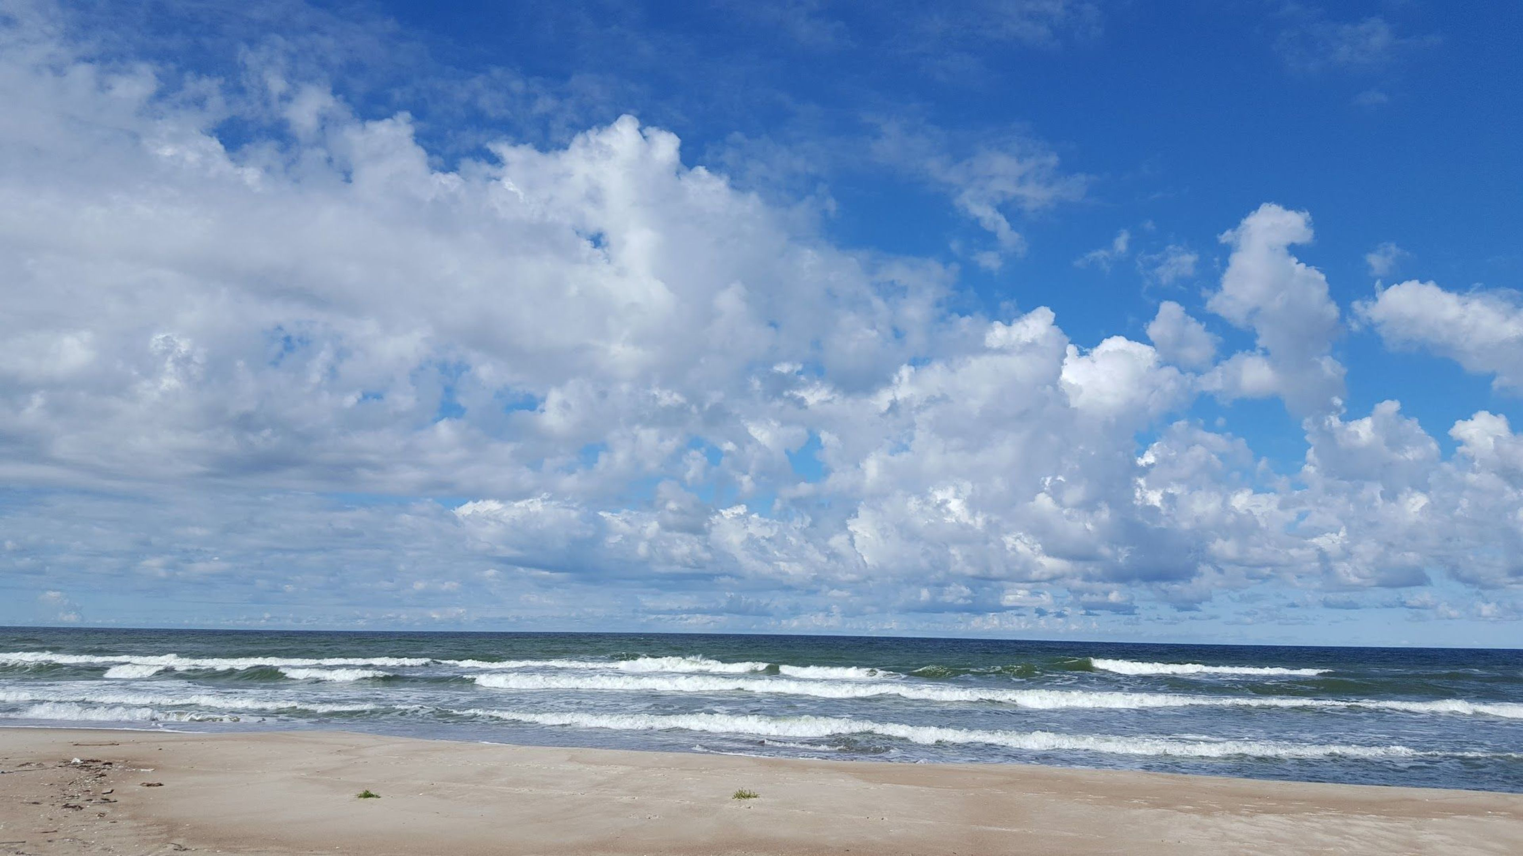

Executive Summary: Key Findings
Quantitative Leadership
Structural Trend
Strategic Priority to 2030
Palanga led among Lithuanian resorts in 2025, yet Druskininkai trailed by only 2.4%. Leadership must be assessed alongside overnight stays, length of stay, and the share of foreign tourists.
The number of overnight stays grew by only 34.4%, whilst tourist arrivals increased by 165.6%. Palanga is attracting more visits, but each tourist is staying for a shorter period.
To shift from increasing tourist numbers towards greater value per tourist: longer stays, more overnight stays during the off-season, and a higher share of foreign tourists.
Key finding: Palanga is the leader in tourism scale, but further progress will depend on its ability to convert large supply into year-round economic value.

